Slide 1
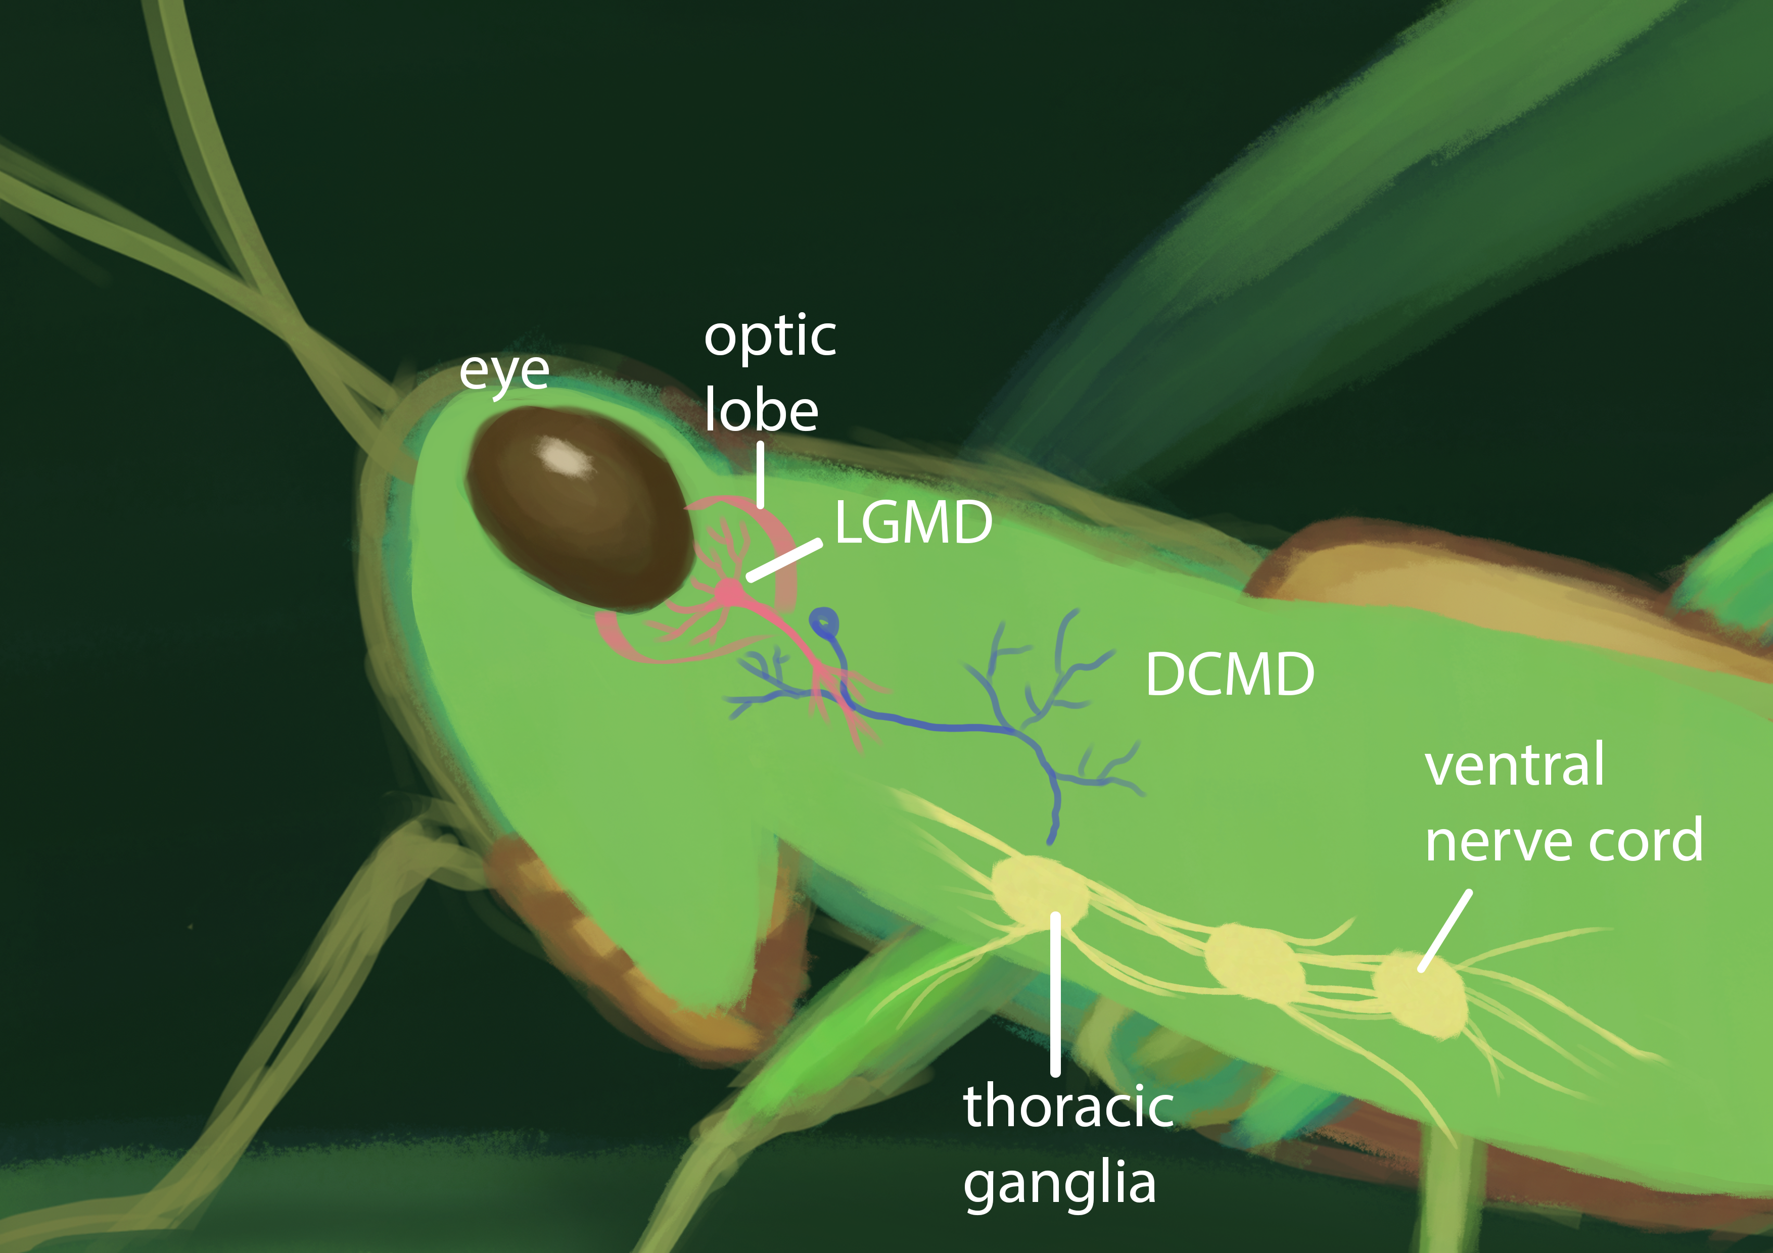
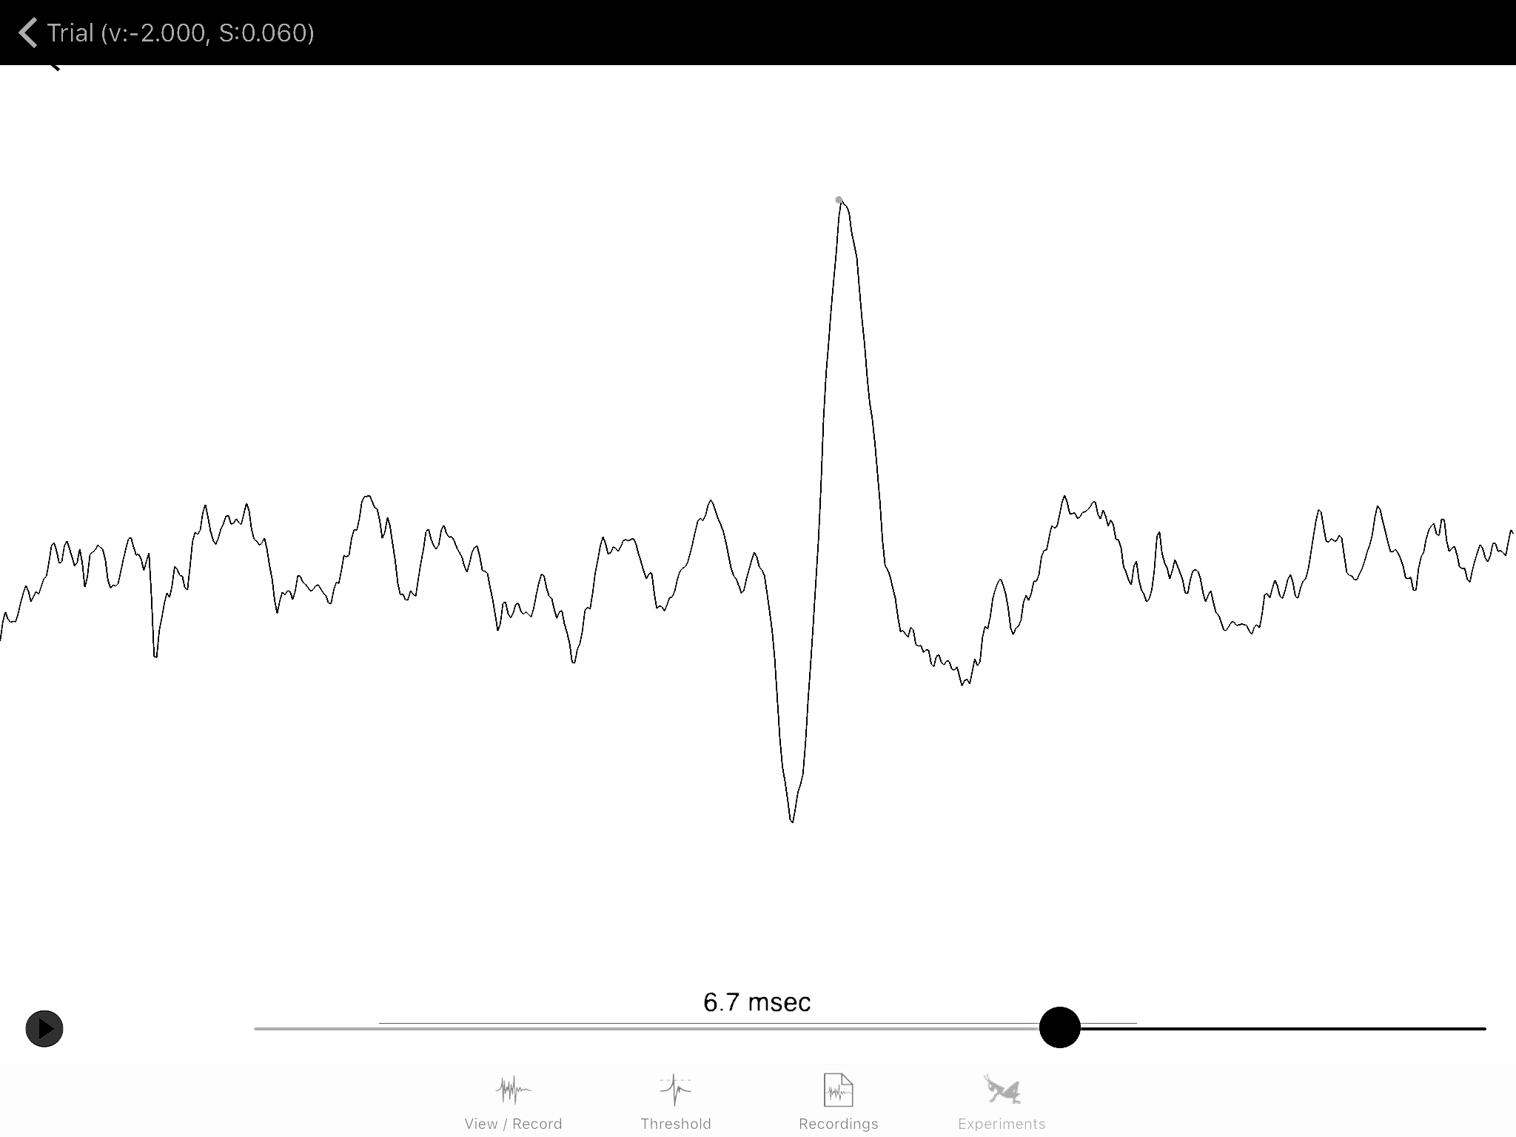
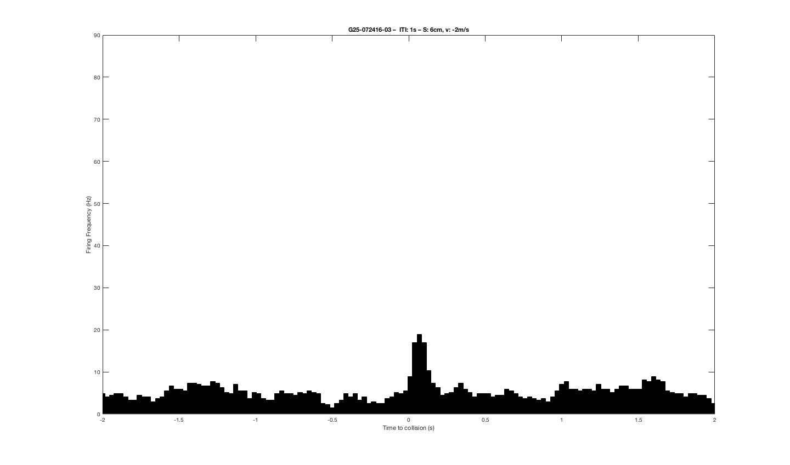
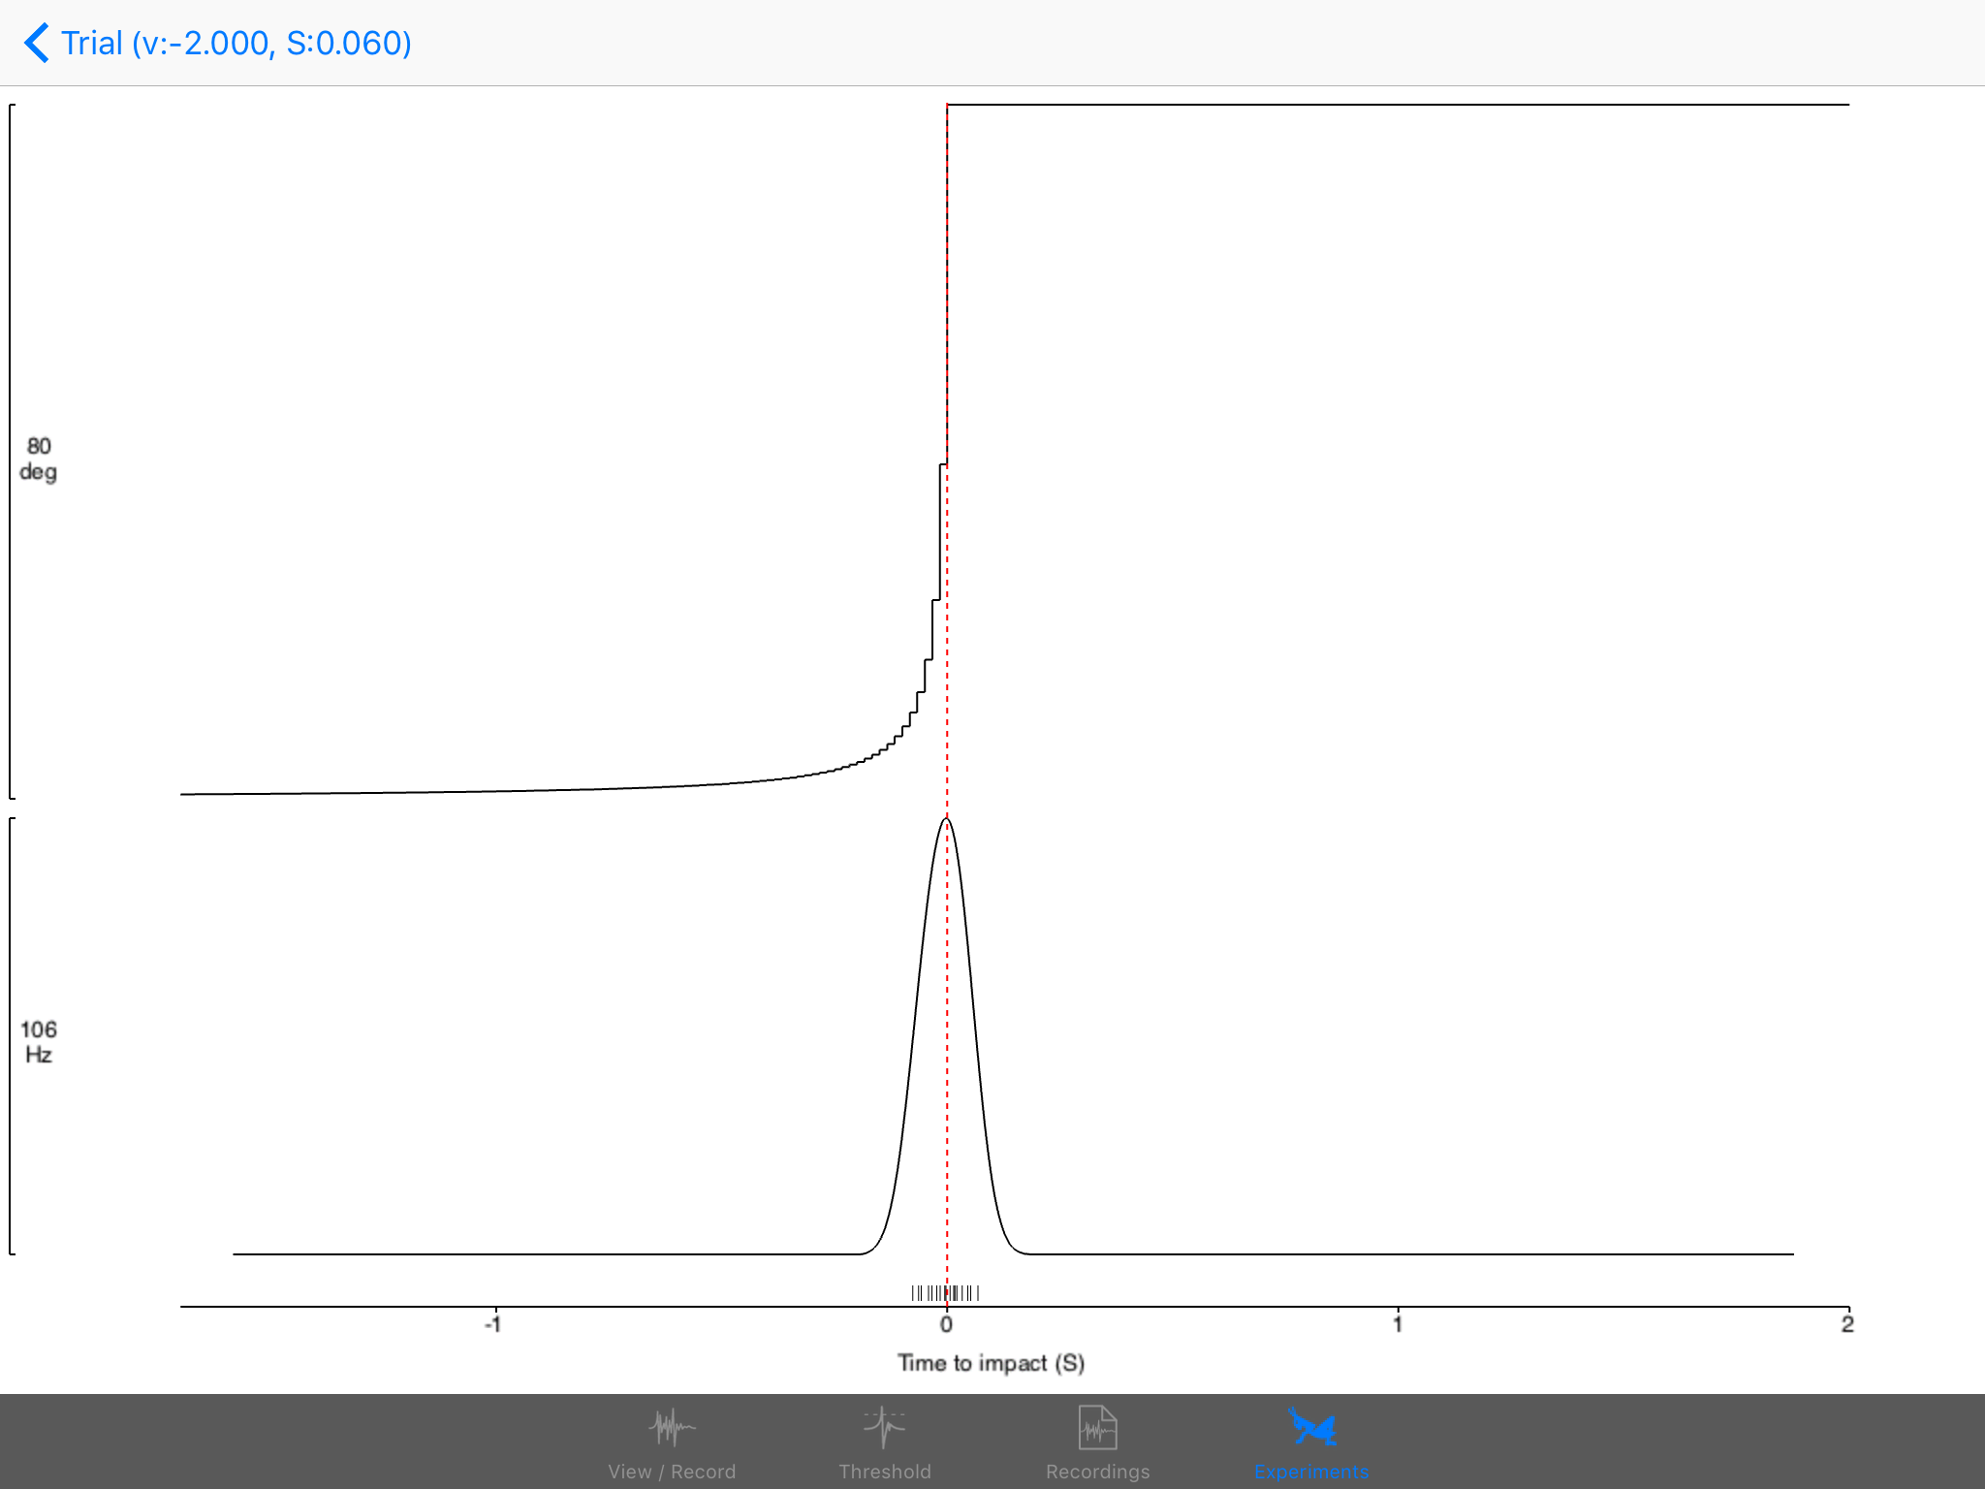
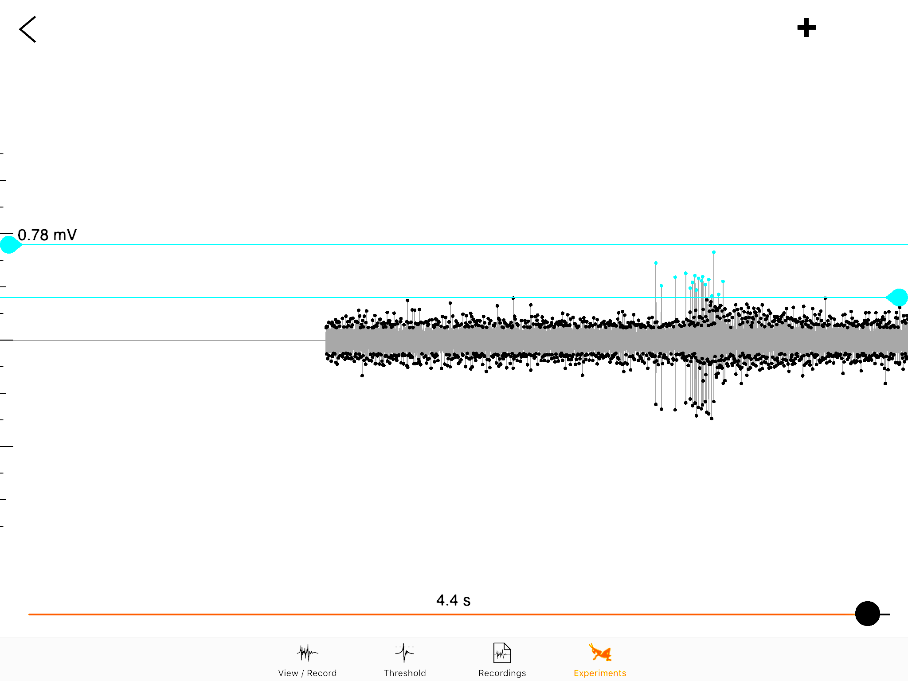
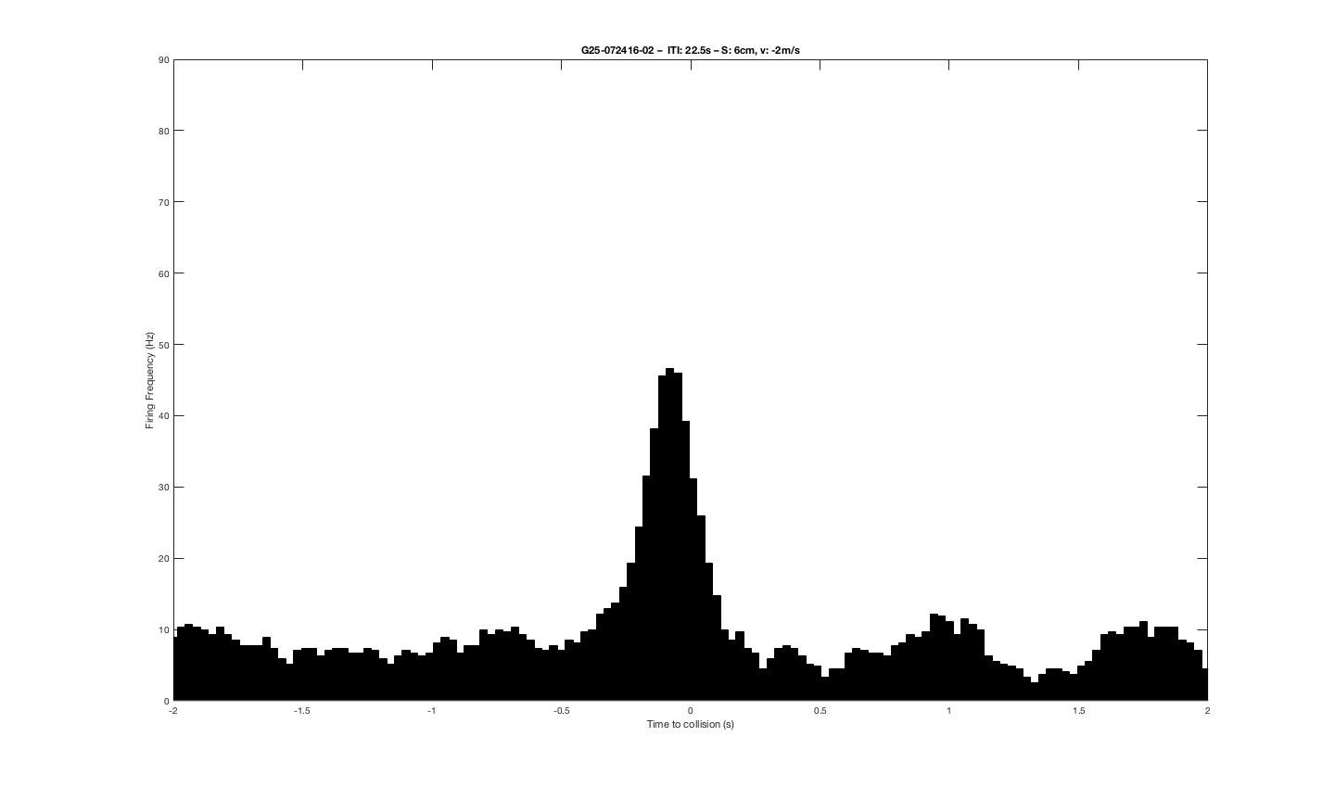
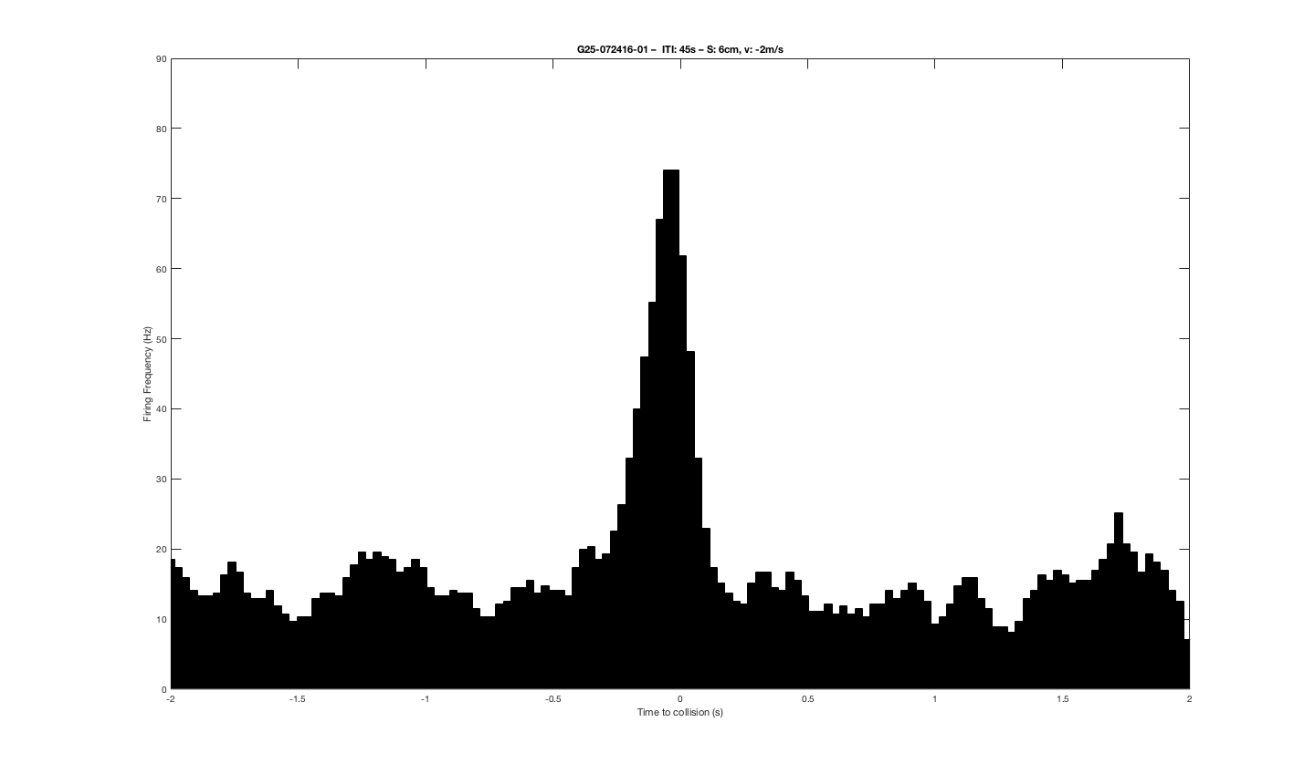
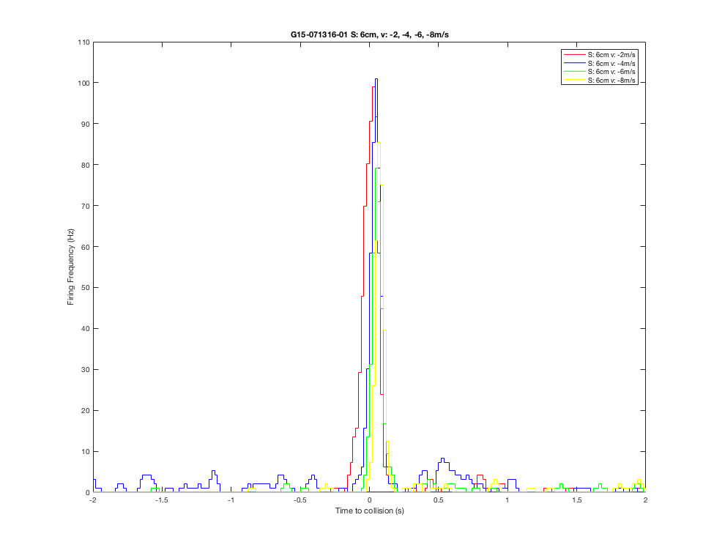
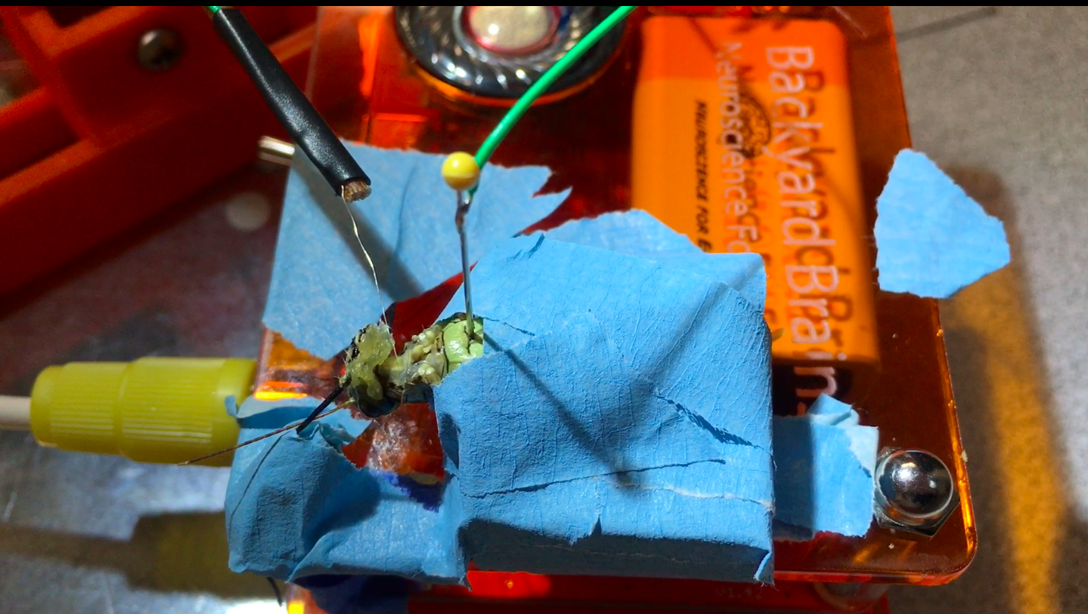
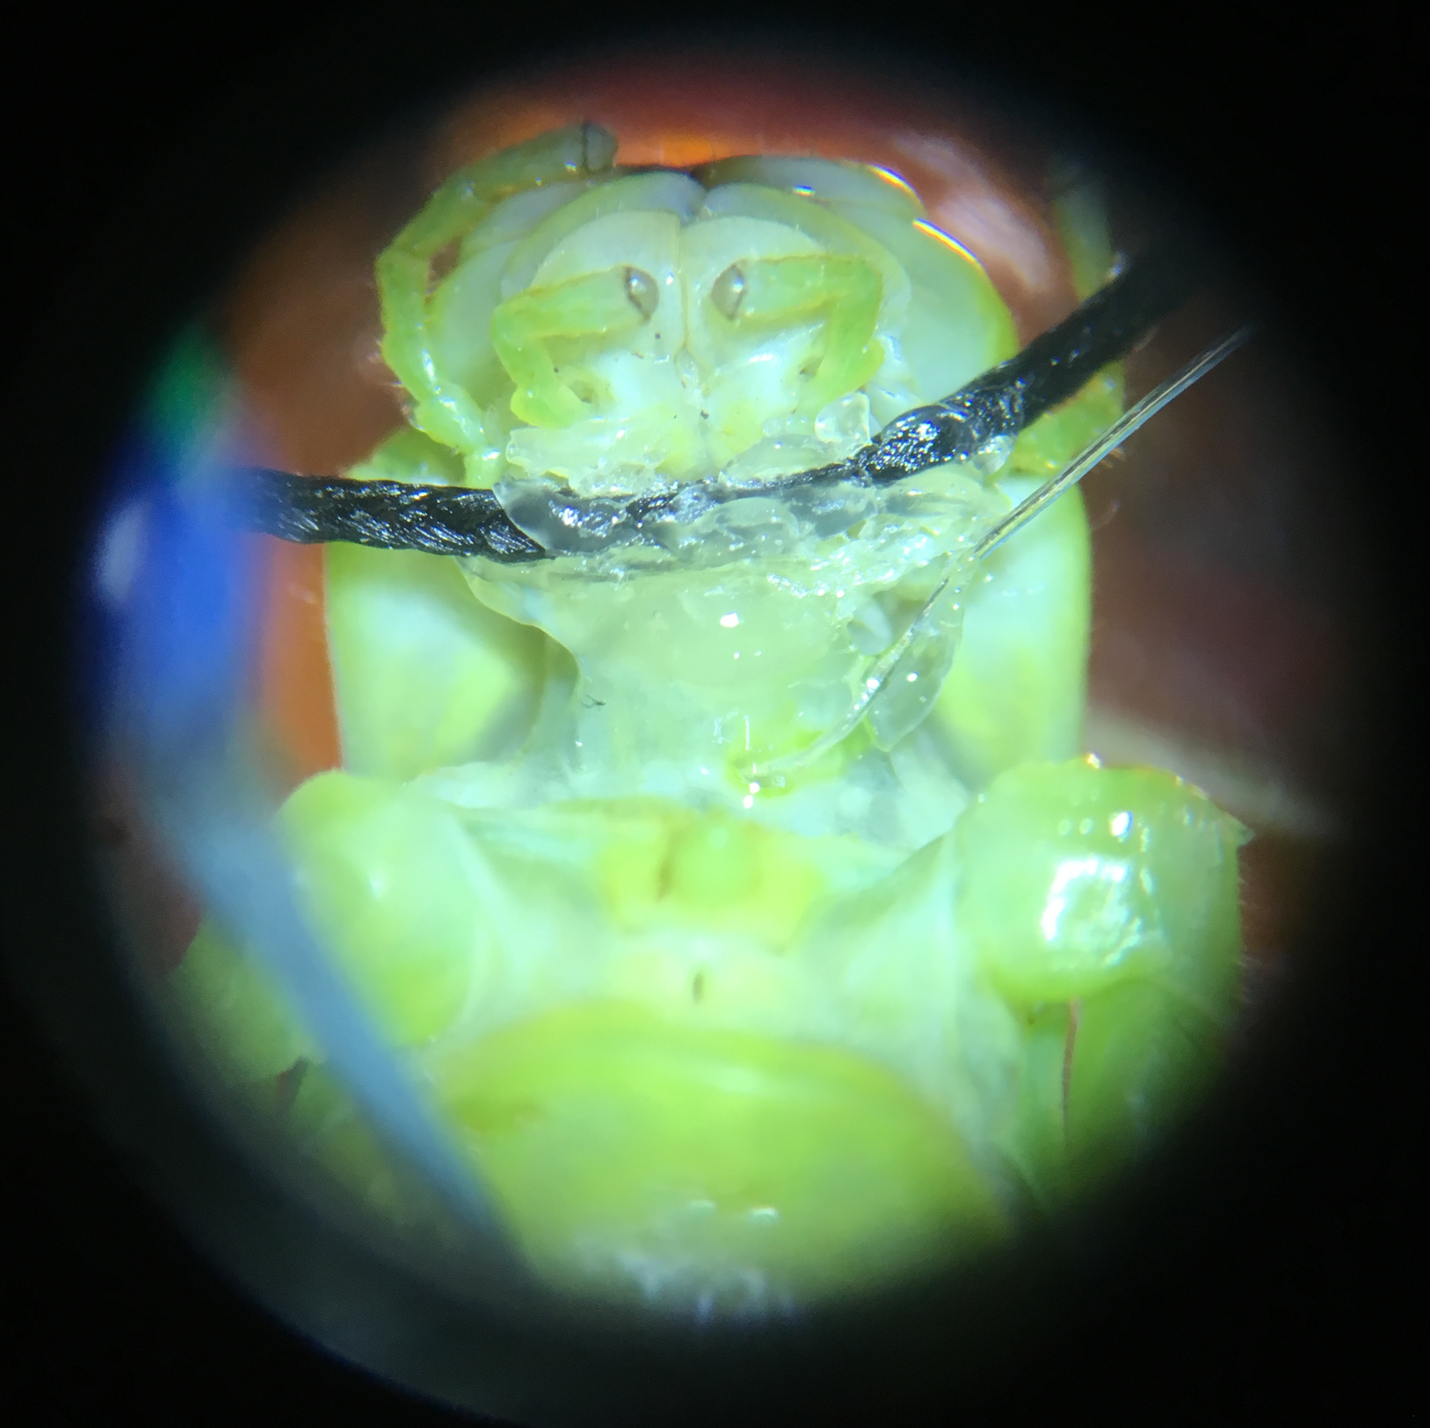
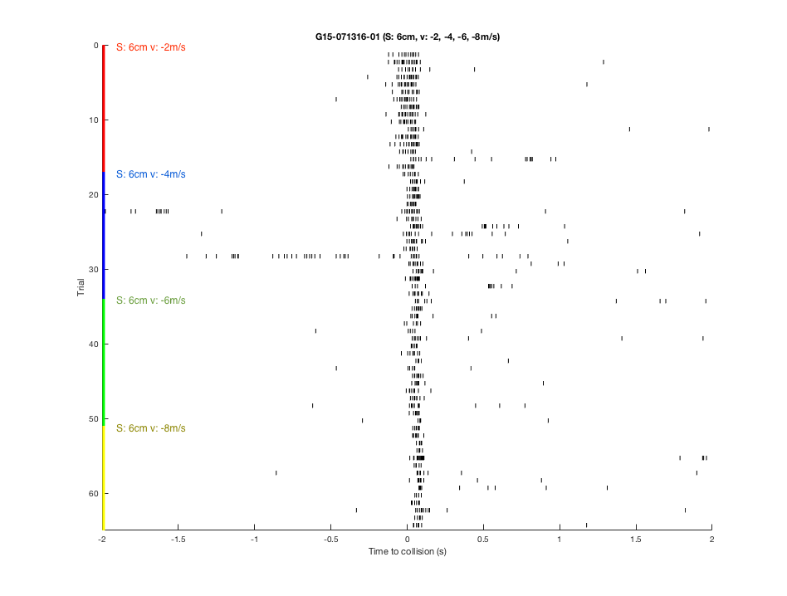
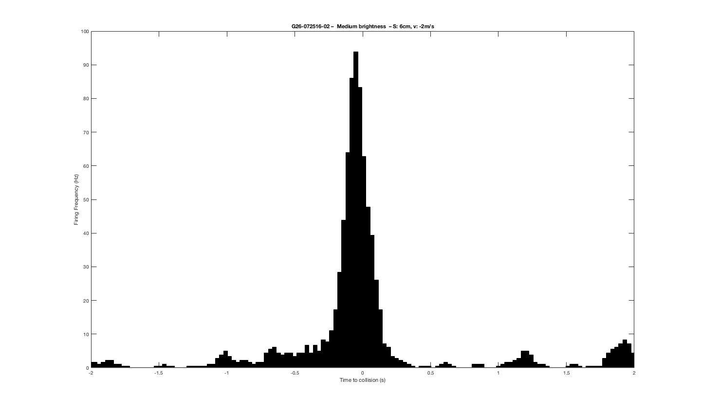
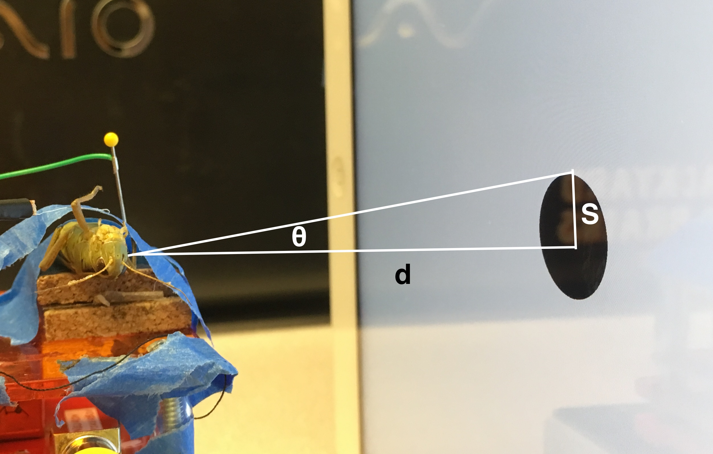
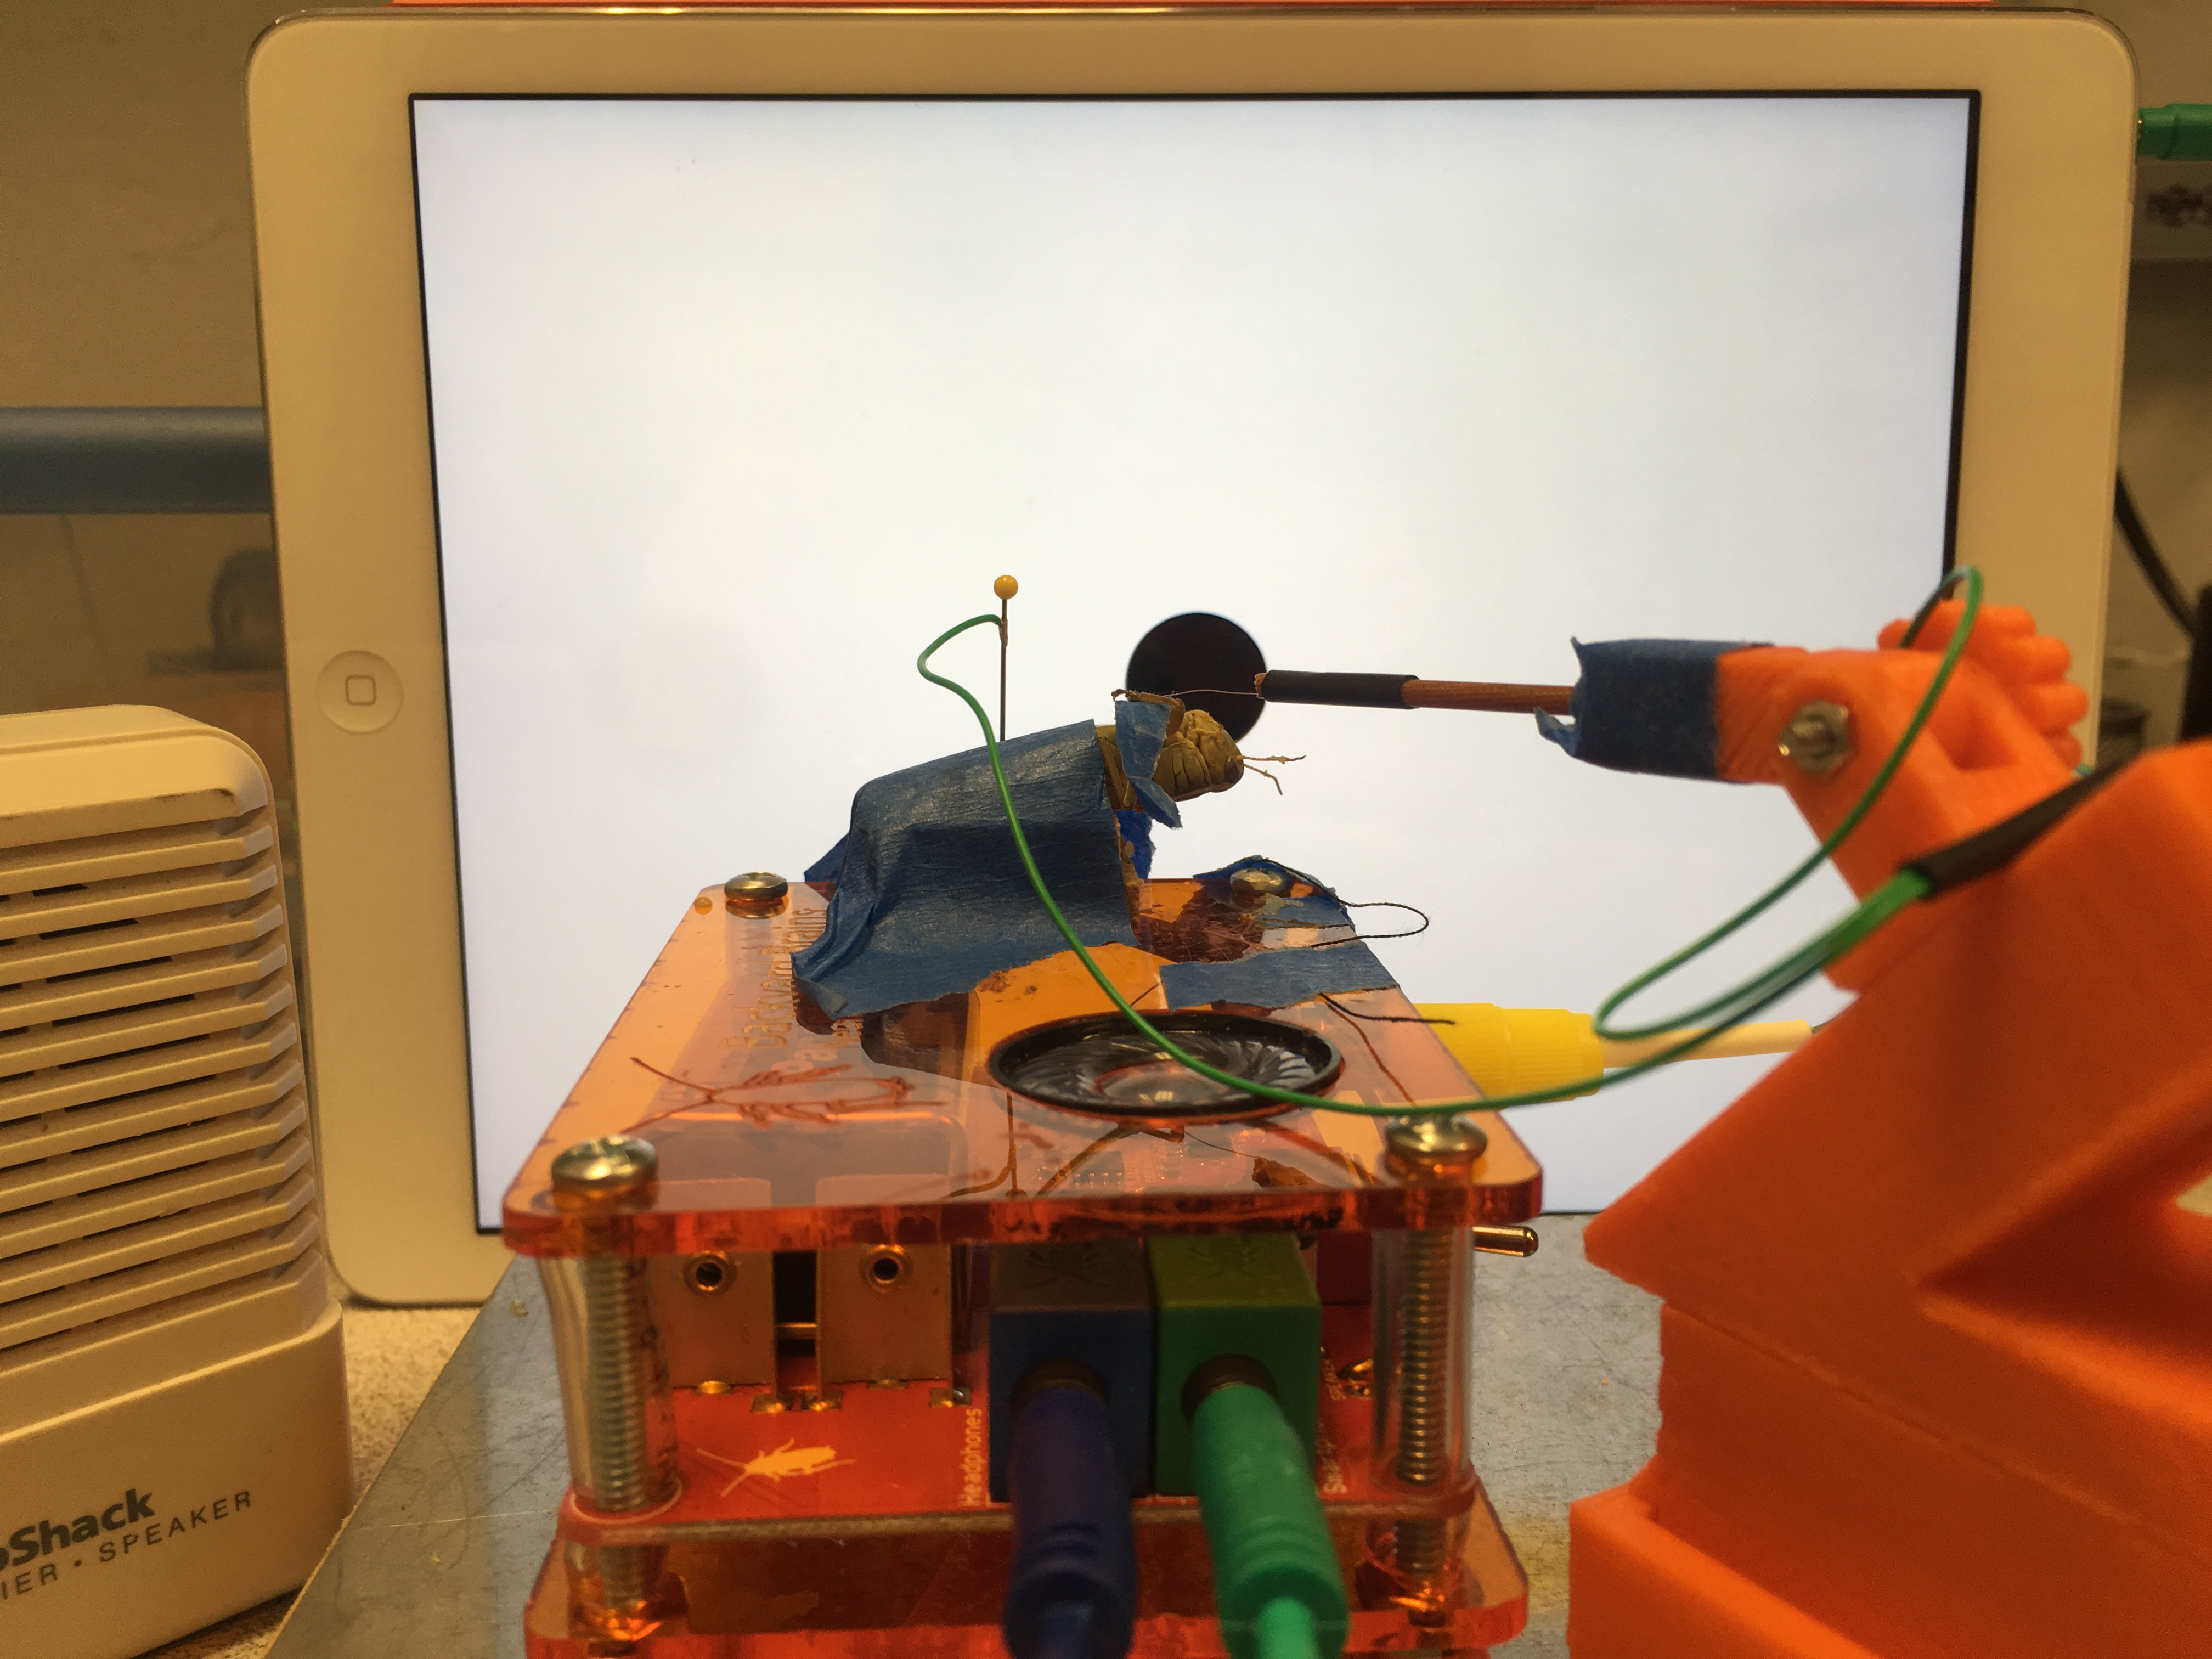
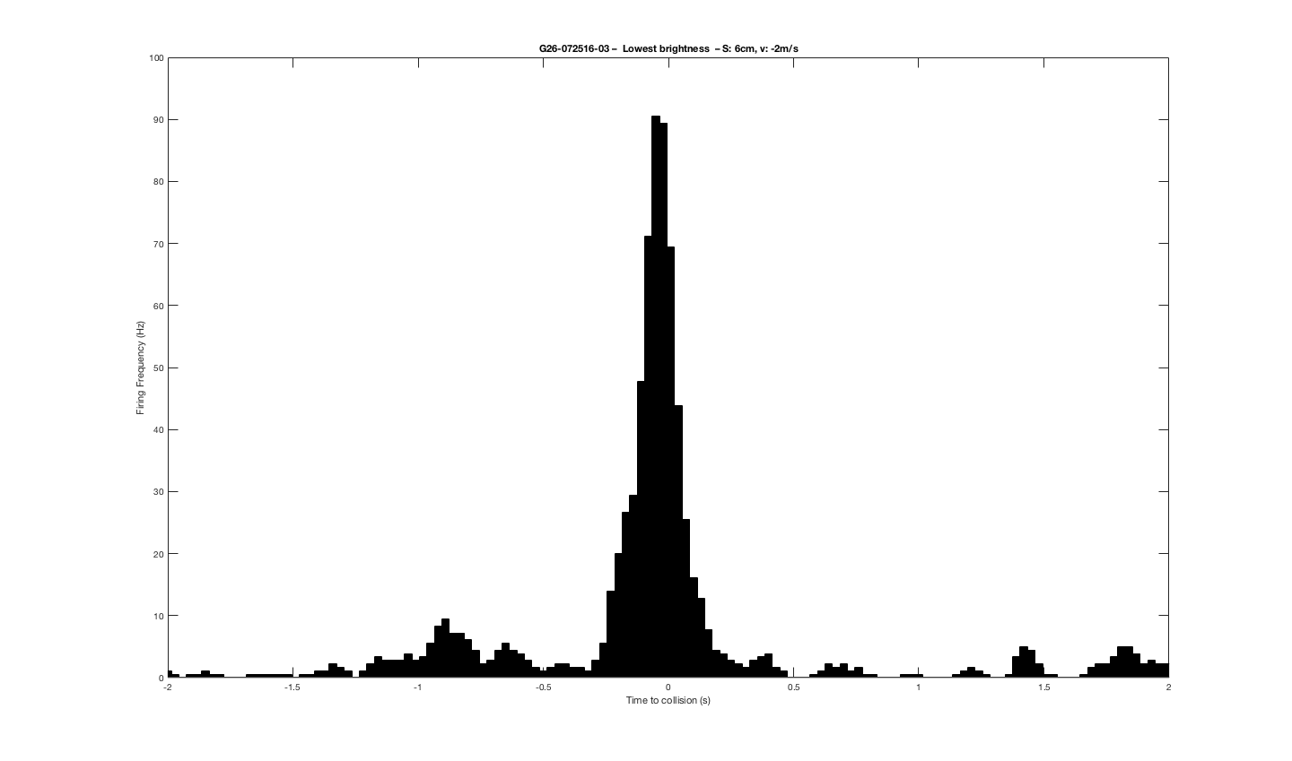
Why are grasshoppers so hard to catch? The motion detector neurons behind the grasshopper’s visual & motor sensitivity to approaching objects Dieu My Nguyen*, Stanislav Mircic, Gregory Gage Backyard Brains, Ann Arbor, MI
Backyard
Brains
INTRODUCTION
Grasshoppers can see an approaching object, such as a predator, and quickly hop away to avoid collision with the object.
© Pearson & O’Shea © Trieu
The grasshopper’s visual system includes two types of motion detector neurons: The lobula giant motion detector (LGMD) neurons are excited by approaching visual stimuli and in turn excites its postsynaptic target, the descending contralateral motion detector (DCMD) neuron that responds to movements detected by the opposite (contralateral) eye by exciting motor neurons⁴.
The DCMD response could be modeled by multiplying object’s angular velocity & size on the retina^{1,2}.
The LGMD & DCMD together make up an early warning system to generate the see-and-jump escape behavior in face of possible collision with approaching objects⁴.
I use Backyard Brains’ (BYB) open source equipment to extracellularly record & analyze the activity of the DCMD when the grasshopper is exposed to approaching visual stimuli.
RESULTS
METHODS
VISUAL STIMULI & SPIKE RECORDING
The BYB SpikeRecorder iPad application provides both the visual stimuli and recording and analysis of DCMD activity. Visual stimuli consist of expanding dark circles (of various sizes and velocities) on a white background to simulate an approaching and colliding object. Parameters in the application include: distance between subject and stimulus/screen, object size and velocity, intertrial interval, and number of trials. Recordings are done in the dark for maximal contrast intensity. Spikes are sorted from noise after recording.
DATA ANALYSIS
Data is imported from the application into MatLab. A database of the experimental data (recording and spike timestamps, stimulus angles, time of collision) is created. Perievent time histograms and raster plots are plotted to visualize firing rate and timing of spikes in relation to stimulus.
WHEN DOES THE DCMD PEAK IN FIRING RATE DURING THE APPROACH OF A VISUAL STIMULUS?
WHAT IS THE ‘IDEAL’ INTERTRIAL INTERVAL TO AVOID HABITUATION OF DCMD RESPONSE TO THE STIMULUS?
A
A: 1s ITI
B
Duration per spike: ~2.3ms
B: 22.5s ITI
C
C: 45s ITI
CONCLUSION
DCMD firing rate peaks around time of collision with an approaching object. The neuron encodes the angular size and velocity of an object, peaking when the image on the retina reaches a certain angular size.
The ‘ideal’ ITI to prevent habituation of the DCMD response is 45s.
Varying screen brightness to alter the contrast intensity between stimulus and screen background does not have a significant effect on the DCMD firing, suggesting that grasshoppers are able to detect objects that do not highly contrast with the background.
Future directions:
Perform mathematical and software tests to ensure the accuracy of calculated time of collision in iPad SpikeRecorder application, to make sense of the instances of peak DCMD firing after the time of collision.
Compare DCMD response to approaching vs receding objects.
Use a wider range of visual stimuli of various colors and motions, in various background clutters to further investigate grasshopper/insect vision.
METHODS
GRASSHOPPER PREPARATION
Figure 3. DCMD response to varying intertrial intervals. Peak firing frequency is around 20, 45, and 75Hz for 1, 22.5, 45s ITI, respectively. The 45s ITI shows the most consistent and frequent firing of the DCMD, and is the ITI of choice for other experiments.
Grasshopper is anesthetized by storage in the fridge for 15min, then mounted ventral side up on corkboard on top of the BYB SpikerBox, head and thorax exposed. The head is pulled back by thread to expose neck connectives (2 white strips) where the recording hook electrode is placed around the contralateral connective, where the DCMD’s axon is. Reference electrode is grounded in abdomen or thorax.
WHAT IS THE EFFECT OF STIMULUS CONTRAST INTENSITY/SCREEEN BRIGHTNESS ON DCMD RESPONSE?
D
Figure 1. Experimental setup (left) Experimental conditions. θ, angle between object edge and focus of expansion; S, radius of circle object; d, distance between screen/stimulus and eye.¹ (right) Grasshopper is exposed to visual stimulus on iPad while the SpikeRecorder application records DCMD activity. Spikes are heard using RadioShack speaker and visualized by app.
Figure 2. DCMD response to approaching objects. d: 10cm; S: 6cm; v: -2, -4, -6, -8m/s; trials per pair of S and v: 30; ITI: 45s. Collision at 0s. (A) A single DCMD spike, approximately 2.3ms from onset of depolarization to end of refractory period. (B) DCMD activity over time and change in angular size (C) Perievent histogram (PETH; bin size: 0.03) of DCMD firing frequency 2s before and after simulated collision between eye and object. (D) Raster plot of DCMD spiking pattern across each pair of S and v over time. DCMD firing peaks around collision for objects approaching at -2m/s, and after collision for objects approaching faster.
References
1. Gabbiani et al. 1999. Computation of object approach by a wide-field, motion-sensitive neuron. J.Neurosci 19(3):1122–1141.
2. Hatsopoulos et al. 1995. Elementary computation of object approach by a wide-field visual neuron. Science 270(5238):1000-1003.
3. Pearson & O’Shea. 1984. Escape behavior of the locust. Springer US.
4. Rind & Simmons. 1992. Orthopteran DCMD neuron... J.Neurophys 68(5): 1654-1666.
Grasshopper anatomy illustration by Cindy Trieu.
SpikerRecorder application by Stanislav Mircic.
*Author contact: dieumynguyen@email.arizona.edu
Figure 4. DCMD response to varying iPad screen brightness. (top) At maximum brightness, DCMD firing rate is consistent and peaks at 95Hz. (bottom) At miminum brightness, firing rate peaks at 90Hz and is not significantly different from activity pattern at full screen brightness.
Funding for this project was supported by NIH Grant #2R44MH093334 and Backyard Brains.
Notes:
Other titles:
-How do grasshoppers escape predators?
WHAT COLORS CAN GRASSHOPPERS SEE?

